Slide 1
Finding and ANALYZING DELETED TWEETS USING WEB ARCHIVES, POLITWOOPS AND SOCIAL FEED MANAGER
Presented By,
Mohammed Nauman Siddique
Graduate Research Assistant at @WSDL

Slide 2
Social Feed Manager and Its Dataset
SFM is an open source software that harvests social media data and web resources from Twitter, Tumblr, Flickr, and Sina Weibo.
Released a dataset of 115th US Congress Tweet Ids
Dataset has approx. 1.9 M Tweet Ids from 27th January 2017 to 20th July 2018
Link to dataset: https://dataverse.harvard.edu/dataset.xhtml?persistentId=doi:10.7910/DVN/UIVHQR

Slide 3
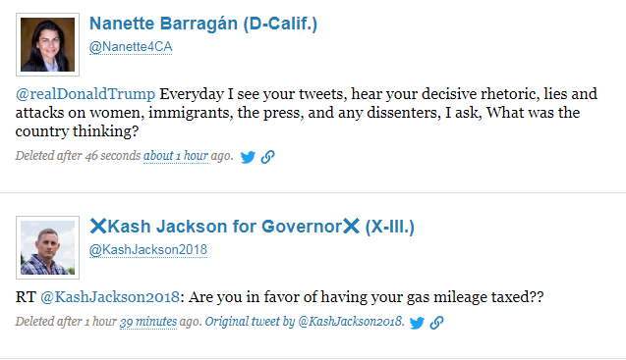
Politwoops and Deleted Tweets
Politwoops tracks deleted tweets by public officials, including people currently in office and candidates running for office.
Fig 1: Screenshot from Politwoops homepage showing deleted tweets

Slide 4
Finding Deleted Tweets Using Web Archives
Given a Twitter Handle
Step 1: Fetch recent 3200 live tweets using Twitter API
Step 2: Fetch Timemap for the URI
Step 3: Fetch and Parse Memento Representations
Step 4: Find the difference in tweet ids between both the sets
Step 5: Check status of difference set on live web using Twitter API and dereferencing the Tweet URI (checking soft 404s)
Link to blogpost: https://ws-dl.blogspot.com/2018/04/2018-04-23-grampa-whats-deleted-tweet.html

Slide 5
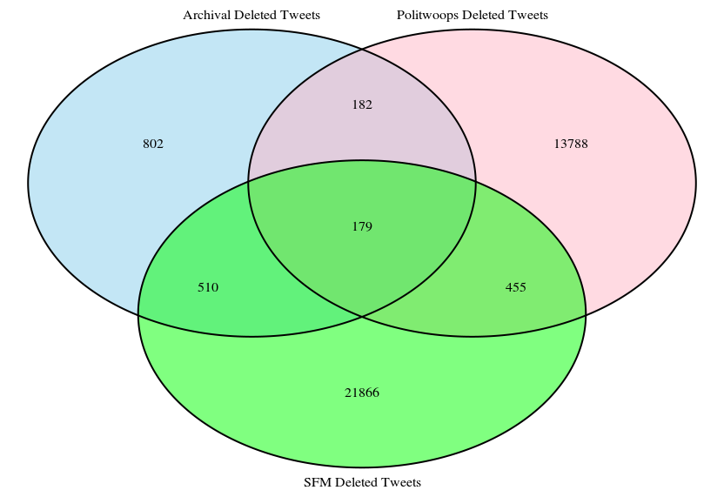
Venn Diagram for Deleted Tweets

Slide 6

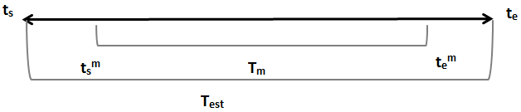
Tweet Estimation for SFM Dataset Timerange
Hard Approach
Loose Approach

